Slide 1
Student Report Card

Slide 2
Presented By
Name :- THAKKAR HARNISH HITESHBHAI
Branch :- Cyber Security Batch :- 25
Subject :- ESFP-II
Enrollment Number :- 21162171033

Slide 3
About Project
Student Report Card As The Name Indicates Will Be Used For Managing Student Records Will Be Used For Various Purposes. Accepting Correct Data Will Results In Generating The Desired Output In Correct Format Without Any Delay.
So This System Has Been Enabled With Validation Data Checkup While Entering The Data Before Saving It To A Particular File. Students Will Also Able To Check Their Data And Modify Their Basic Information As Per Requirements.

Slide 4
Content In Project
File Handling Has Been Used For The Effective Implementation Of All The Typical Features With This Project.
The Key Features To Student Report Card System Are :
1) Create Student Report Card Record :- This Feature Creates A New Student Record Containing His Marks. For This Information To Be Provided Are The Name And Roll Number Of The Student And The Marks Of Subjects.

Slide 5
2) Read All Students Report Card Record :- The Void Display All() Function In This Student Report Card System Project In C++ Has Been Used For This Feature. It Basically Shows The Progress Report Of All The Students Added In File.
3) Read Specific Student’s Report Card Record :- This Feature Is Same As The One Explained Above, Except It Shows The Progress Report And Relevant Data Related To A Particular Student.

Slide 6
4) Display All Student’s Grade Report :- This Feature Enlisits All The Student’s Record Saved In File. The Grade Report Is Displayed In A Tabular Form With Roll Number And Name Of Students, And Marks Achieved In The Subjects, And The Grade Percentage Obtained By Them.
5) Modify Student’s Report Card Record :- In Student Report Card System Project In C++, This Feature Is Used To Edit The Report Card Record Of A Particular Student.

Slide 7
6) Delete Student Record :- This Feature Deletes The Report Card Record Of A Particular Student.

Slide 8
Header Files Used
#include<iostream>
#include<fstream>
#include<iomanip>

Slide 9
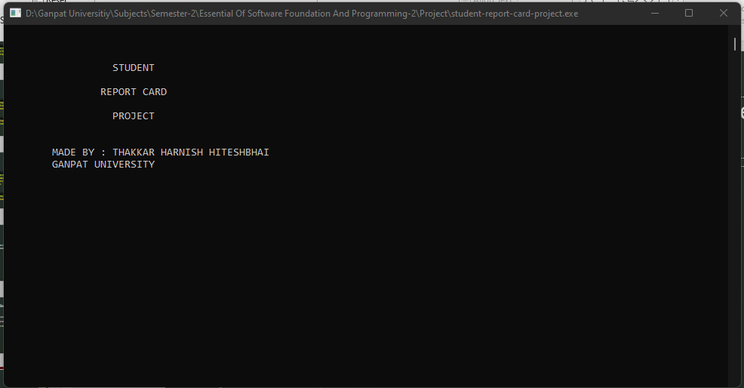

Slide 10
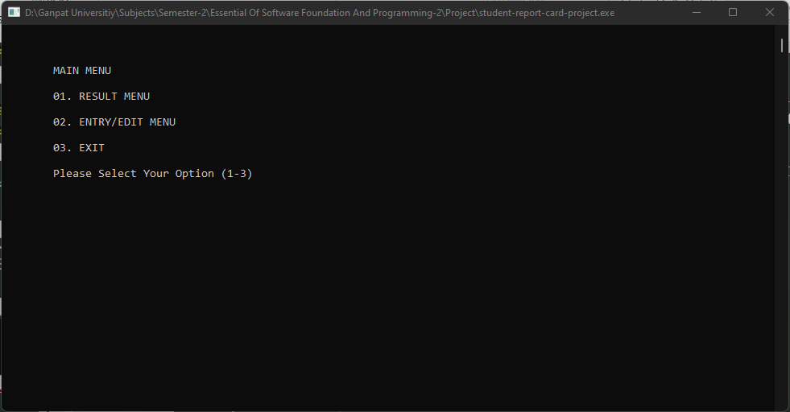

Slide 11
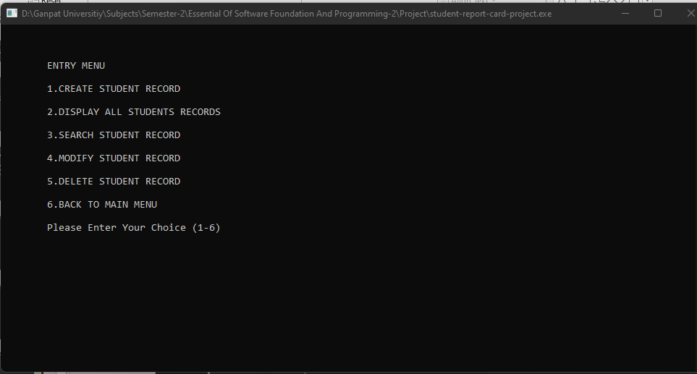

Slide 12
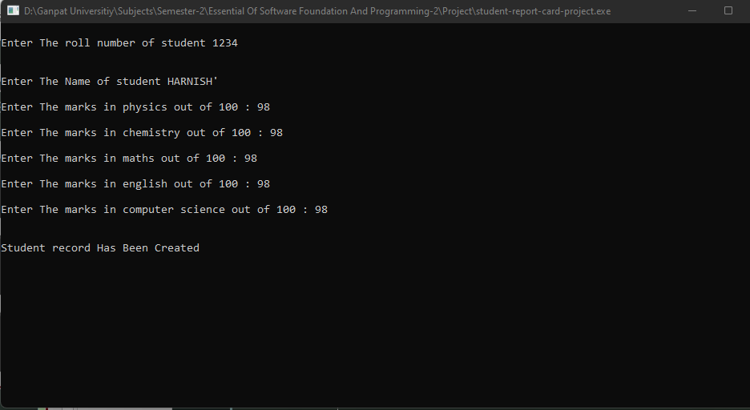

Slide 13
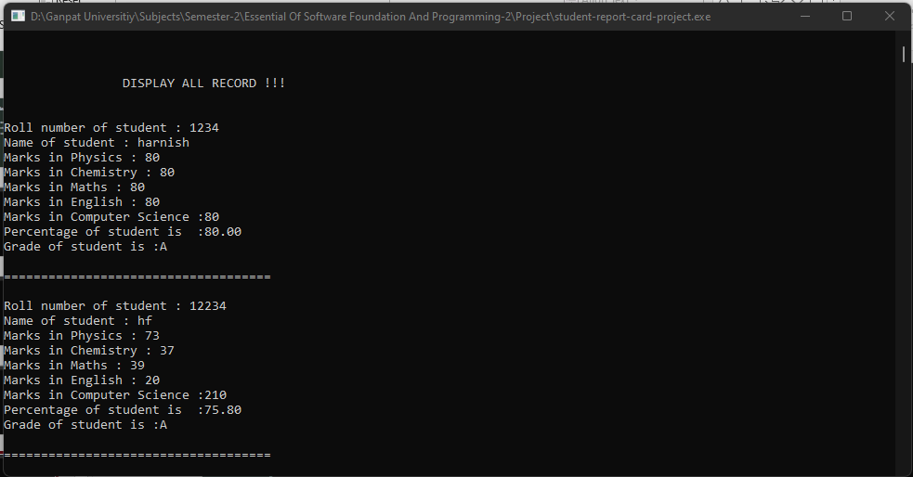

Slide 14
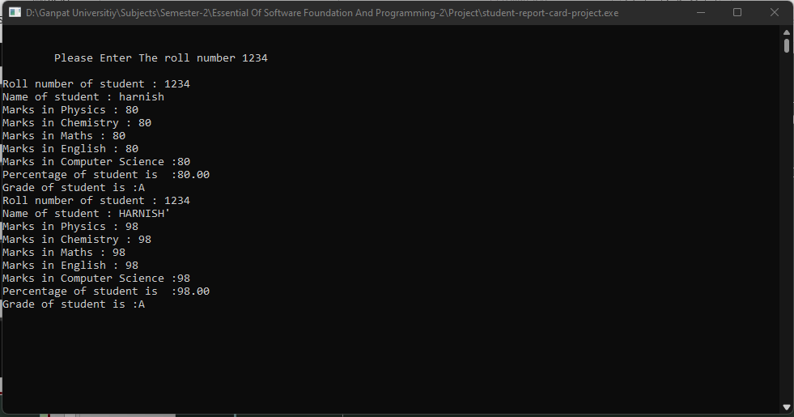

Slide 15
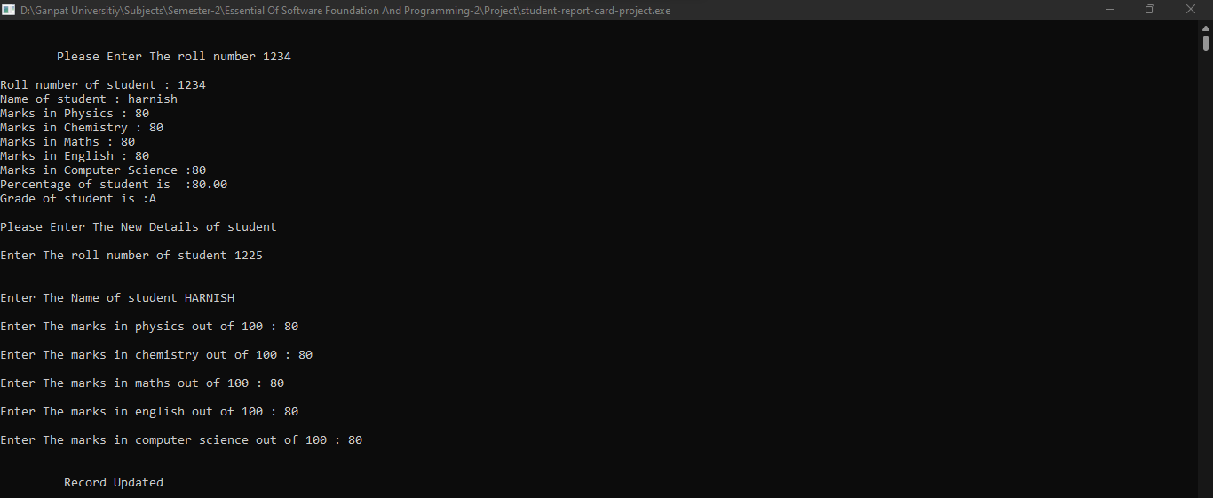

Slide 16
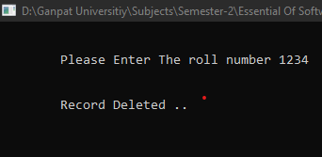

Slide 17
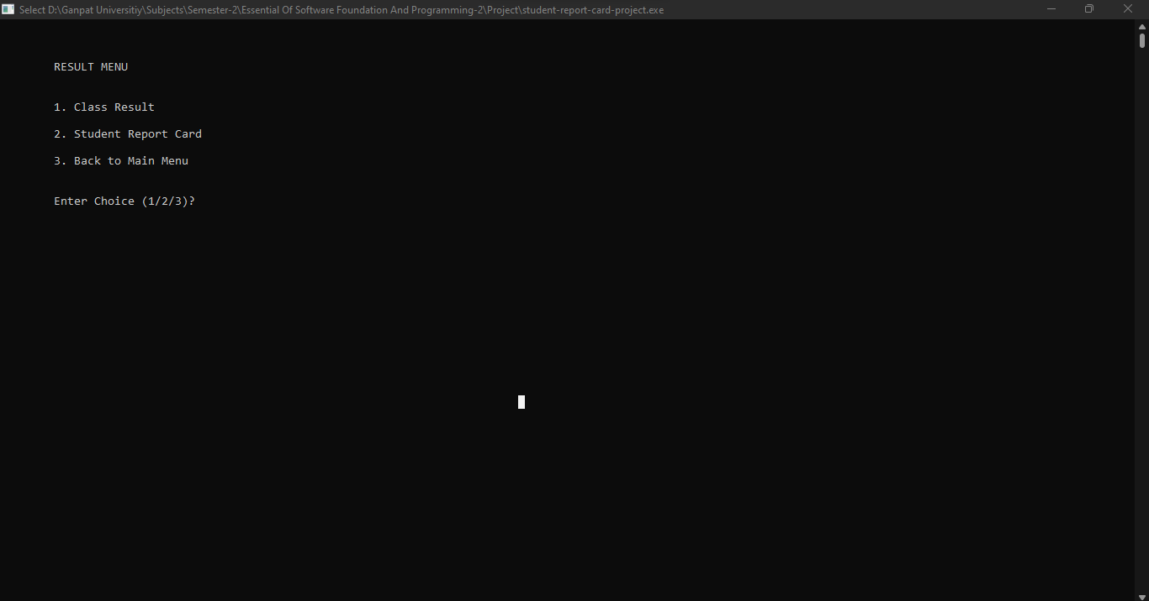

Slide 18
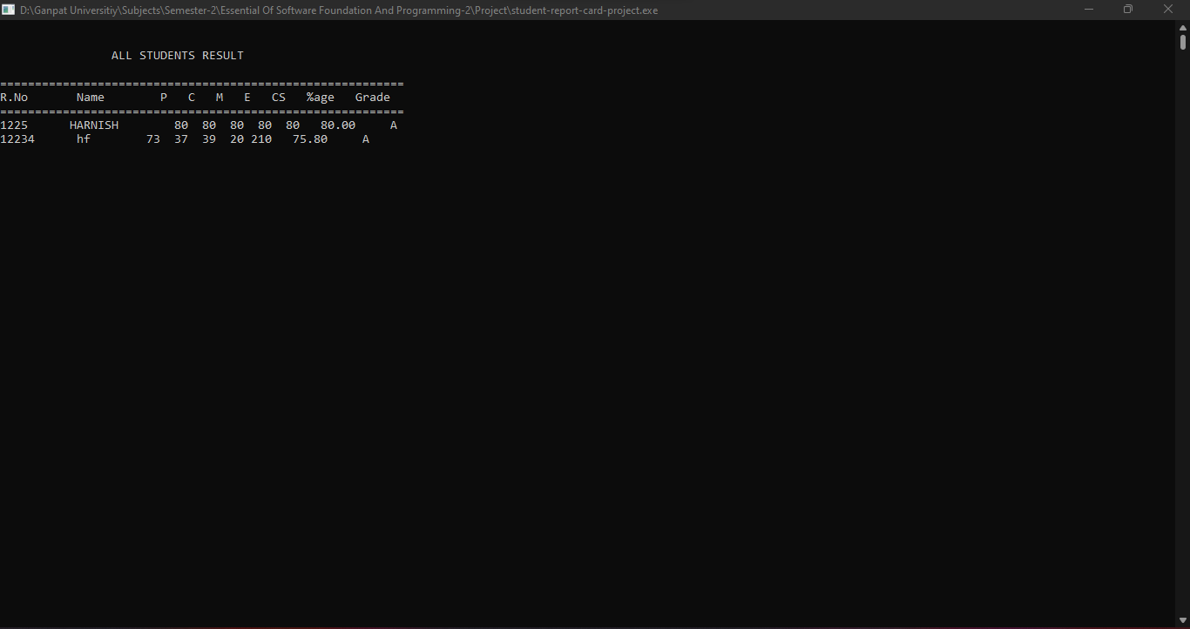

Slide 19
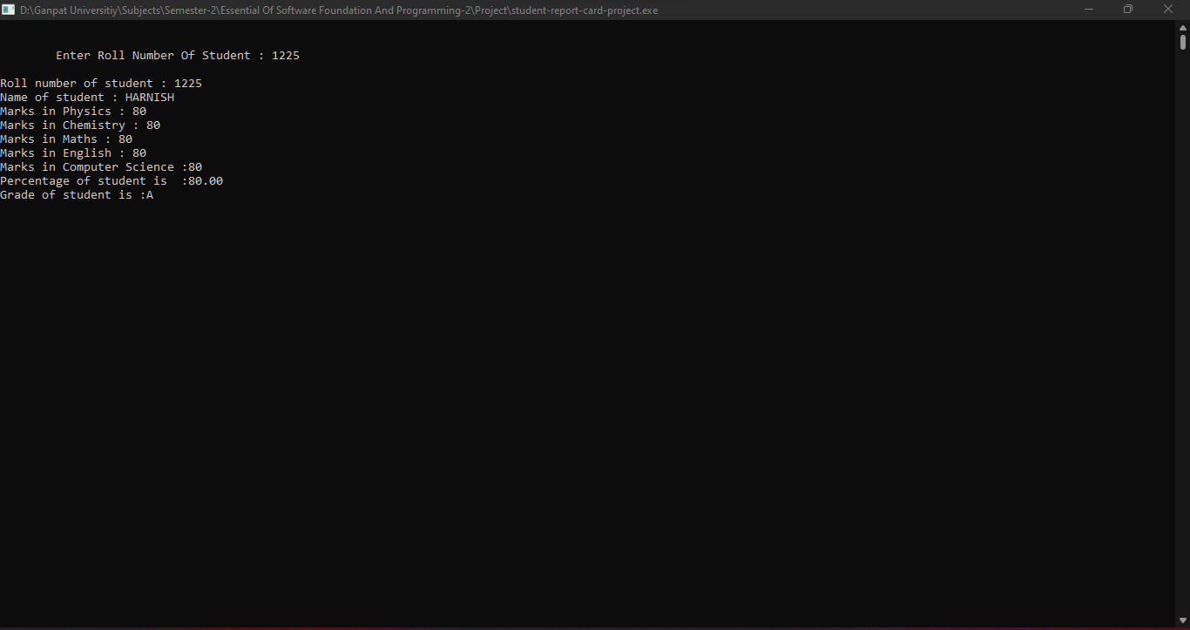

Slide 20
THANK YOU !

